Slide 1
Using Q-learning and Neural networks to develop a state controller for fixed wing aircraft:
Yash Manian

Slide 2
Contents
Background
Framing the problem
Q-learning with ε-greedy policy
Reward Matrix and Final Q-table
Results from the Q-learning algorithm
LQR v/s Q-learning
Future goals

Slide 3
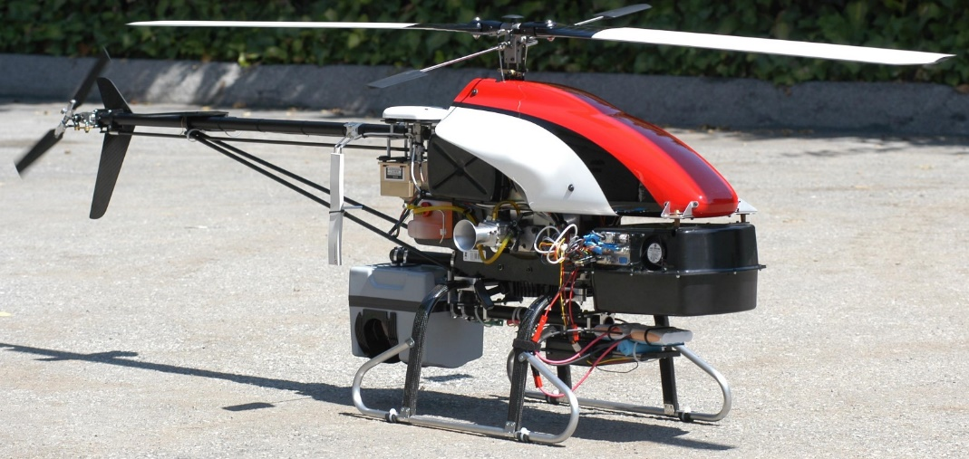
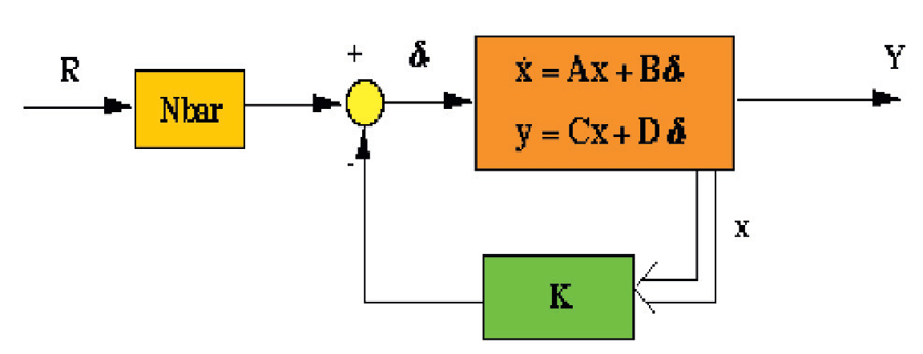
Background
This project was inspired by the Stanford Autonomous helicopter.
It uses Q-learning to learn and control the dynamics of a fixed wing aircraft.
Since a simulator for the aircraft couldn’t be found, a system of dynamical equations were derived to act as the simulator and output the states of the system based on the actions taken

Slide 4
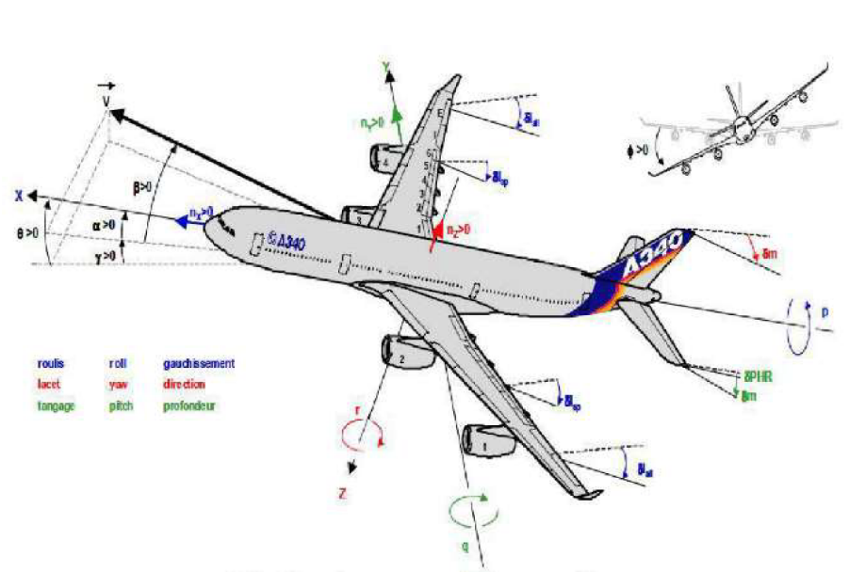
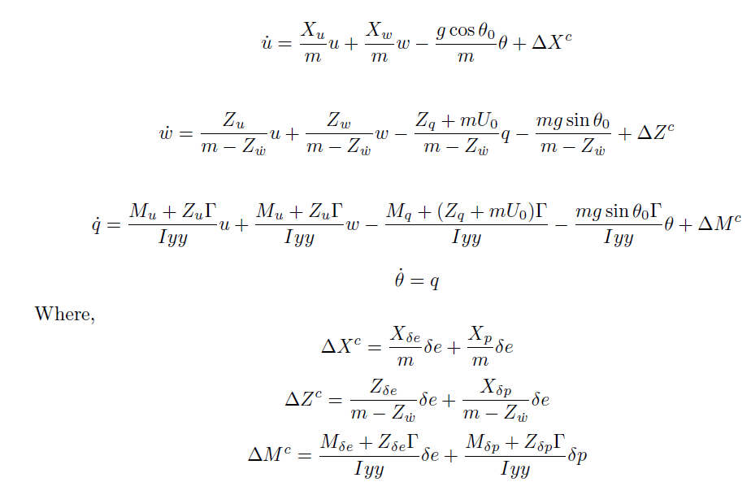
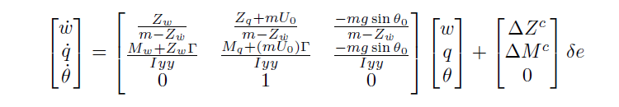
Framing the problem
Chosen states for longitudinal controller:
Vertical velocity (v)
Pitch rate (q)
Pitch angle (θ)
System of equations:

Slide 5
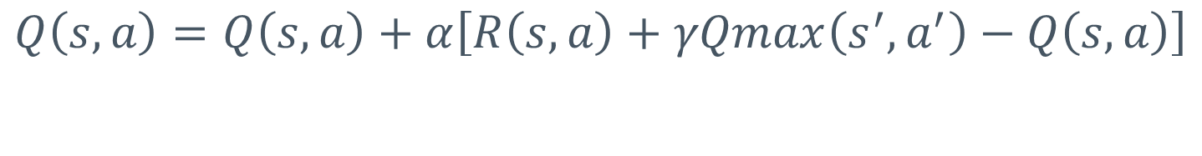
Q-learning with ε-greedy strategy
$$Q\left(s,a\right)=Q\left(s,a\right)+α\left[R\left(s,a\right)+γQmax\left(s^{′},a^{′}\right)−Q\left(s,a\right)\right]$$
States 1: Error < -0.1 rad
States 2: Error > 0.1 rad
States 3: -0.1 < Error < 0.1 rad
Action 1: +0.05 rad
Action 2: -0.05 rad
Action 3: +0.00 rad
ε = 0.1
ϒ = 0.8
α = 0.5

Slide 6
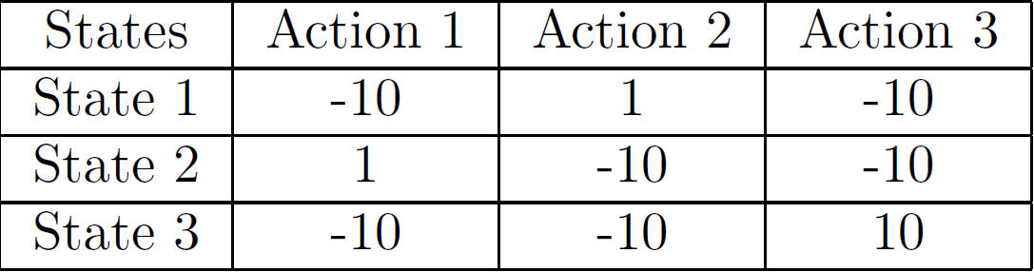
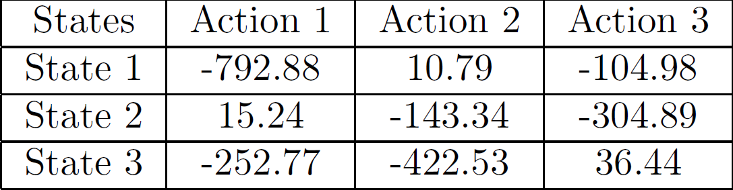
Reward Matrix and final Q-table
Reward
Q-values

Slide 7
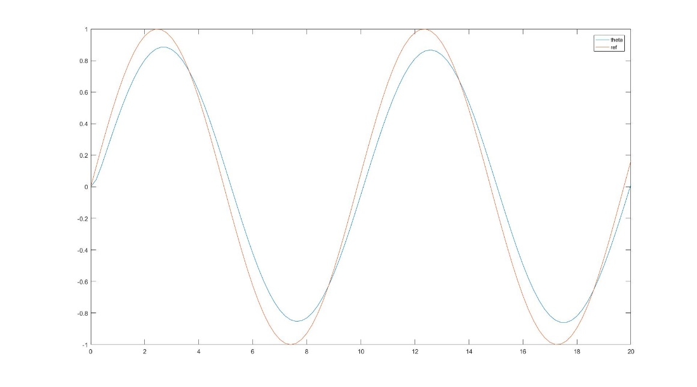
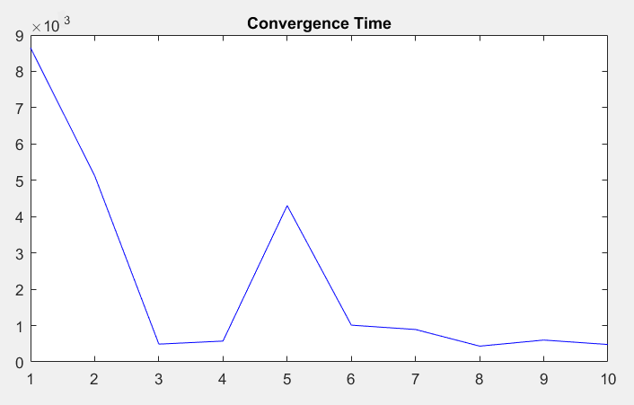
Results from the Q-learning algorithm
Time taken for convergence to constant value
Across 10 episodes
Convergence to time dependent signal
across 20 seconds

Slide 8
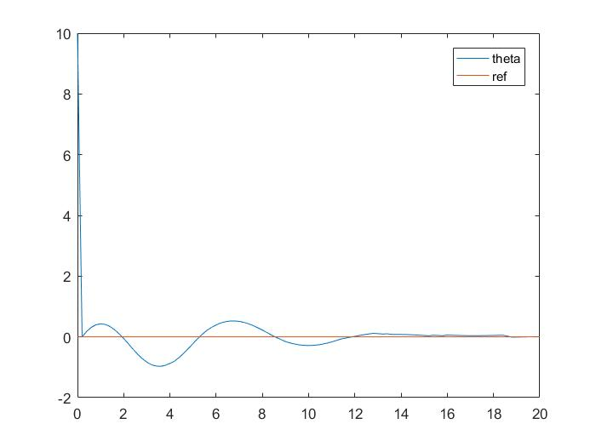
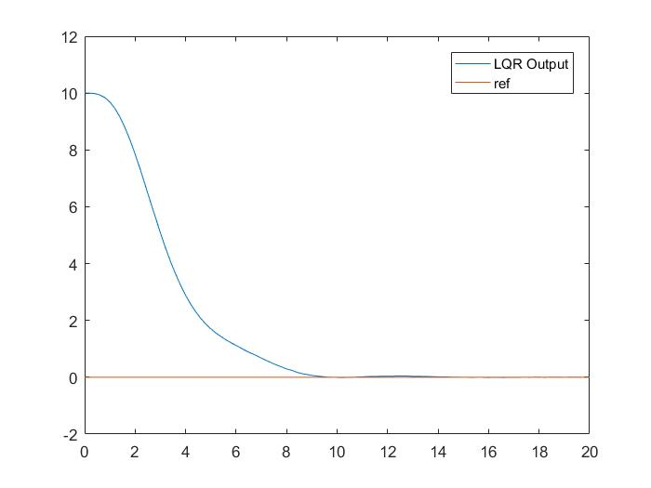
LQR v/s Q-learning
LQR convergence to zero from
initial state
Q-learning controller converging to zero from initial state

Slide 9
Future goals
Lateral Motion states
Non-linearities in system dynamics
Vector tracking

Slide 10
Thank you

